Slide 1

Patent citation networks
in the United Kingdom
University College London
Centre for Advanced Spatial Analysis
Joe B. George
Prof. Elsa Arcaute

Slide 2
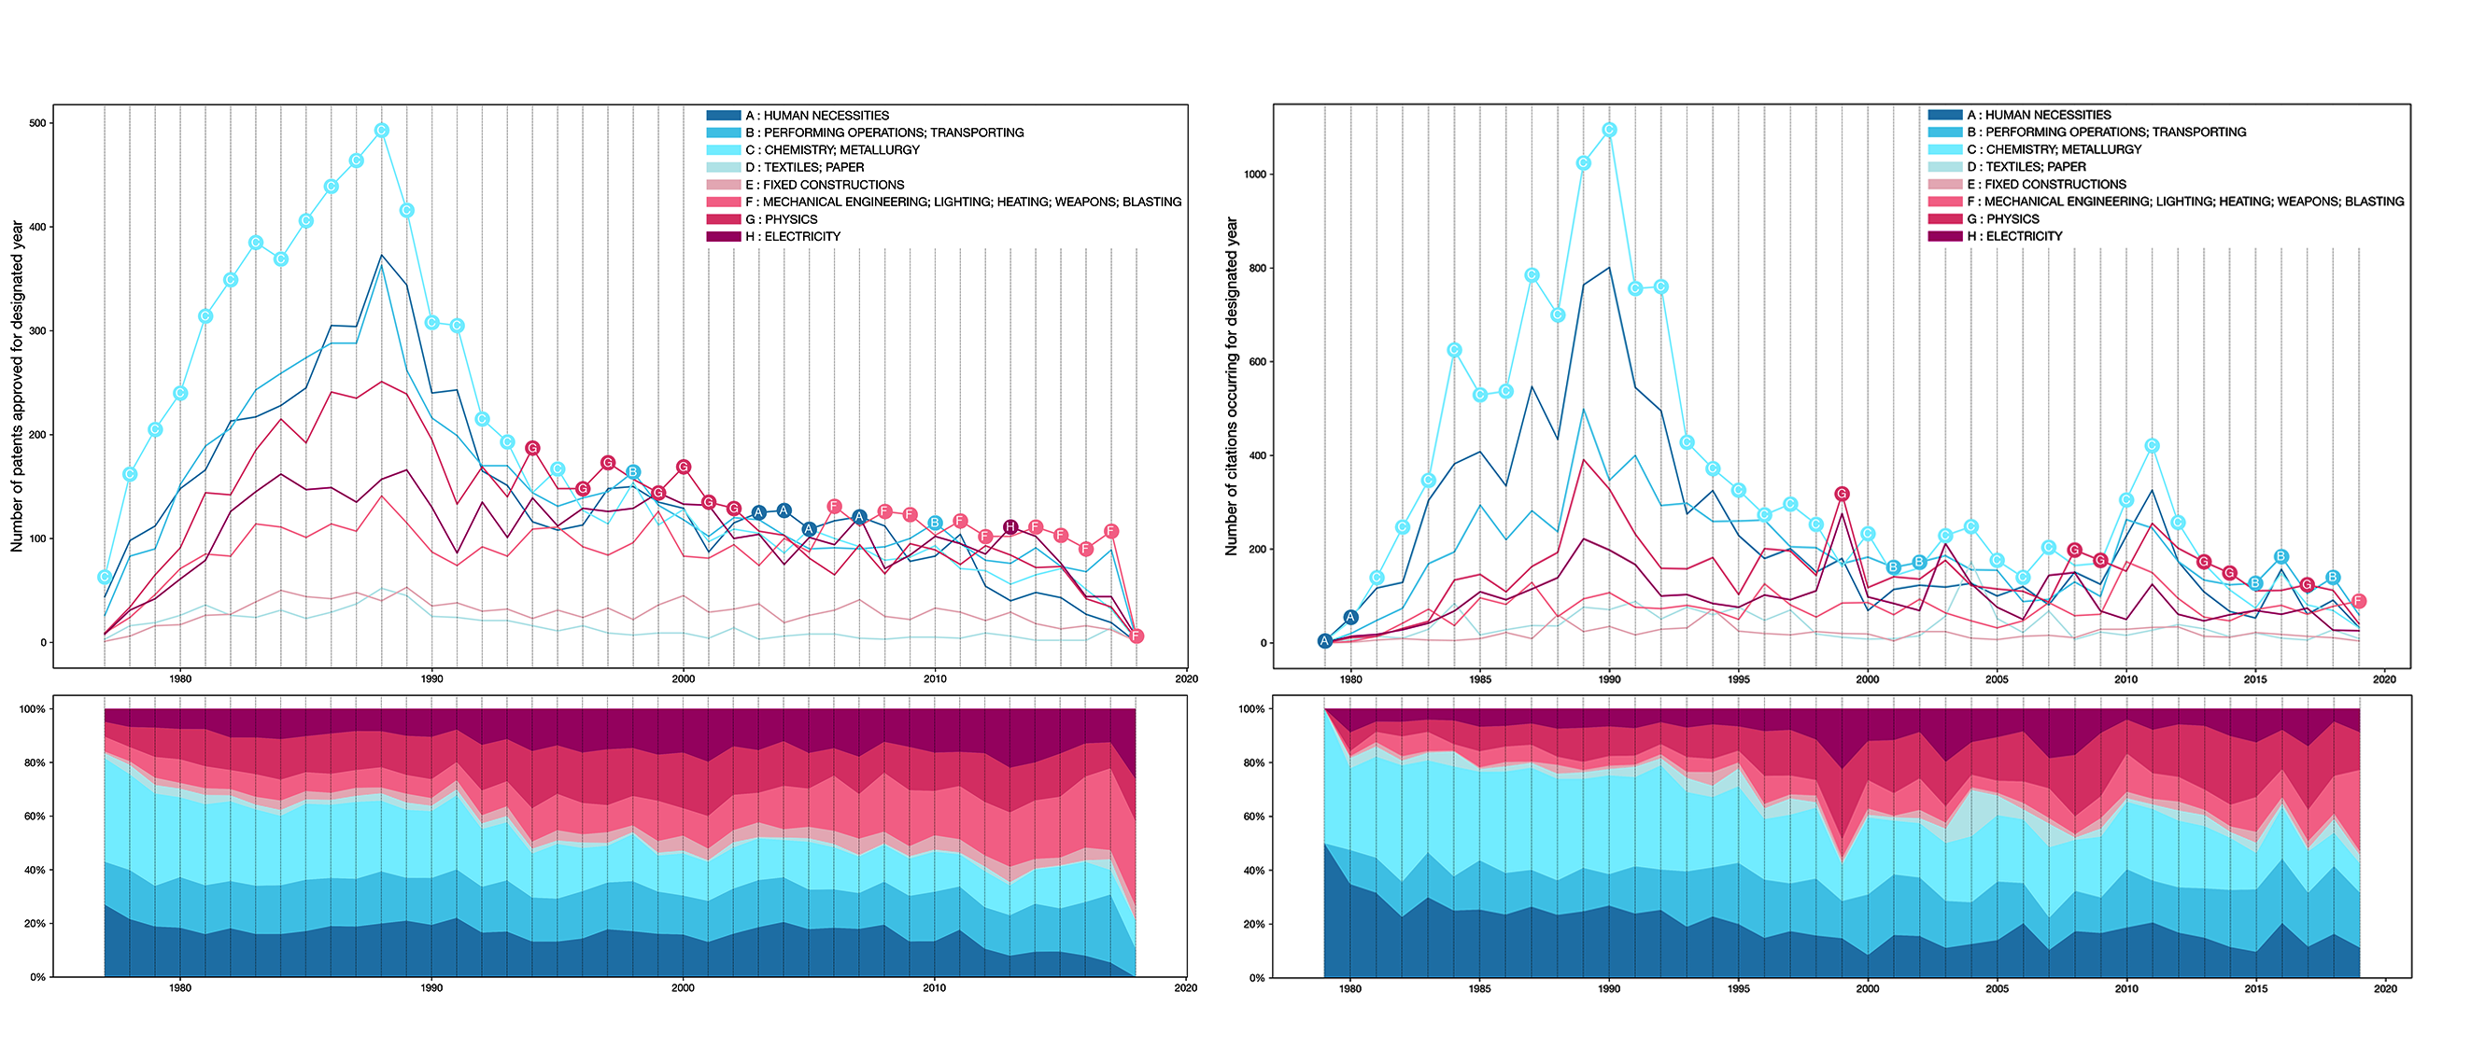
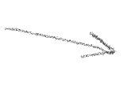

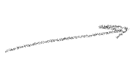
Fig. 1: Number of IPC category occurrences for the patents approved (left) and the citations within the class (right).

Slide 3
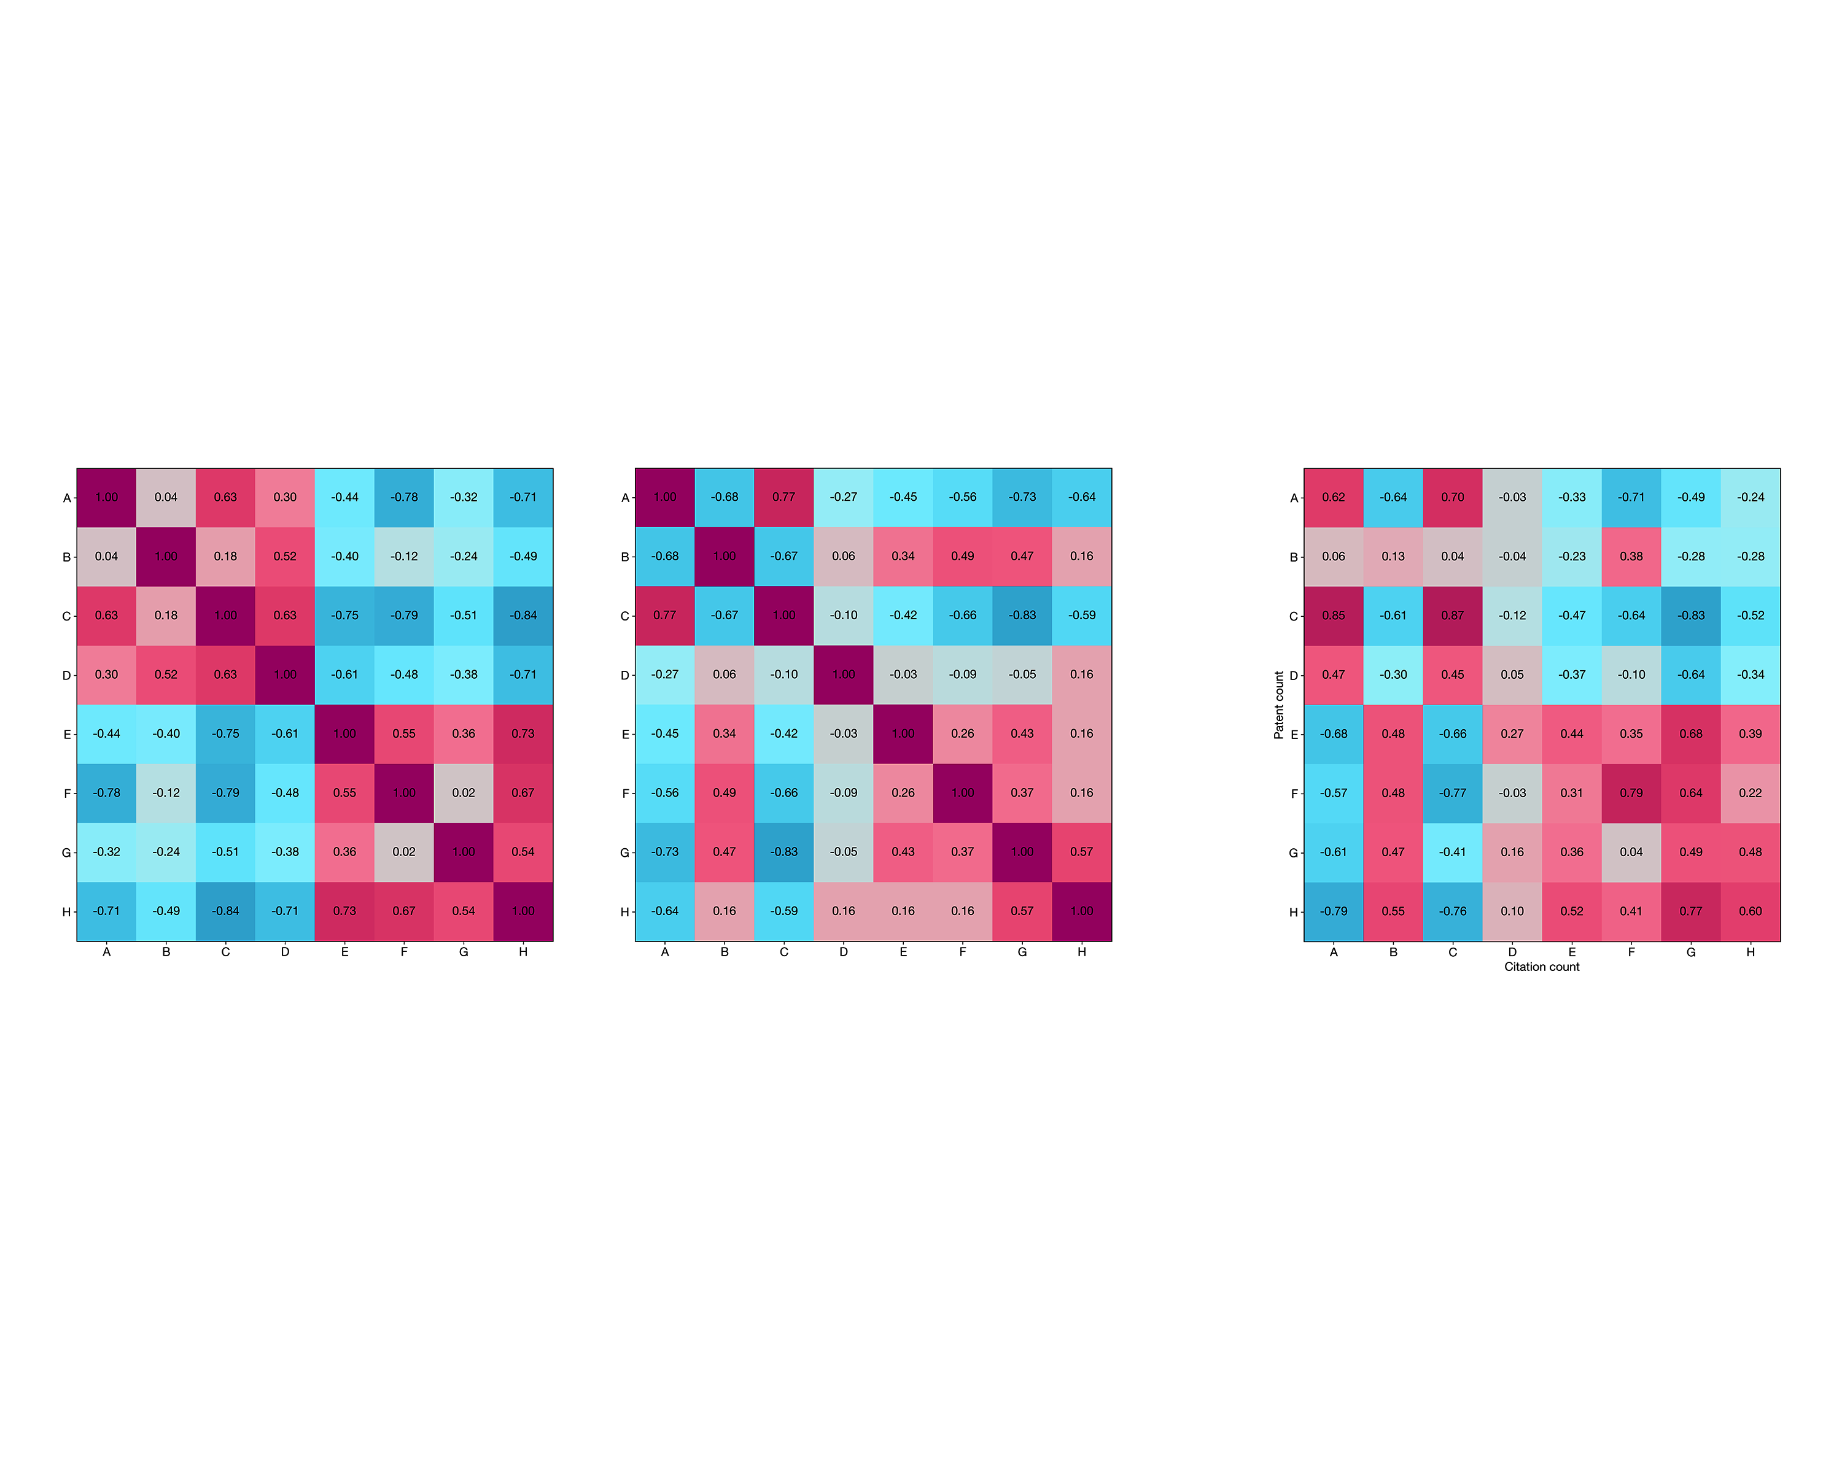





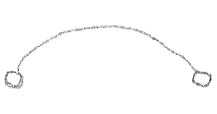







Fig. 2: Correlation matrices for the normalised patent counts (left) and the normalised citation counts (right).
Fig. 3: Cross-correlation between the latter patent and citation counts.

Slide 4
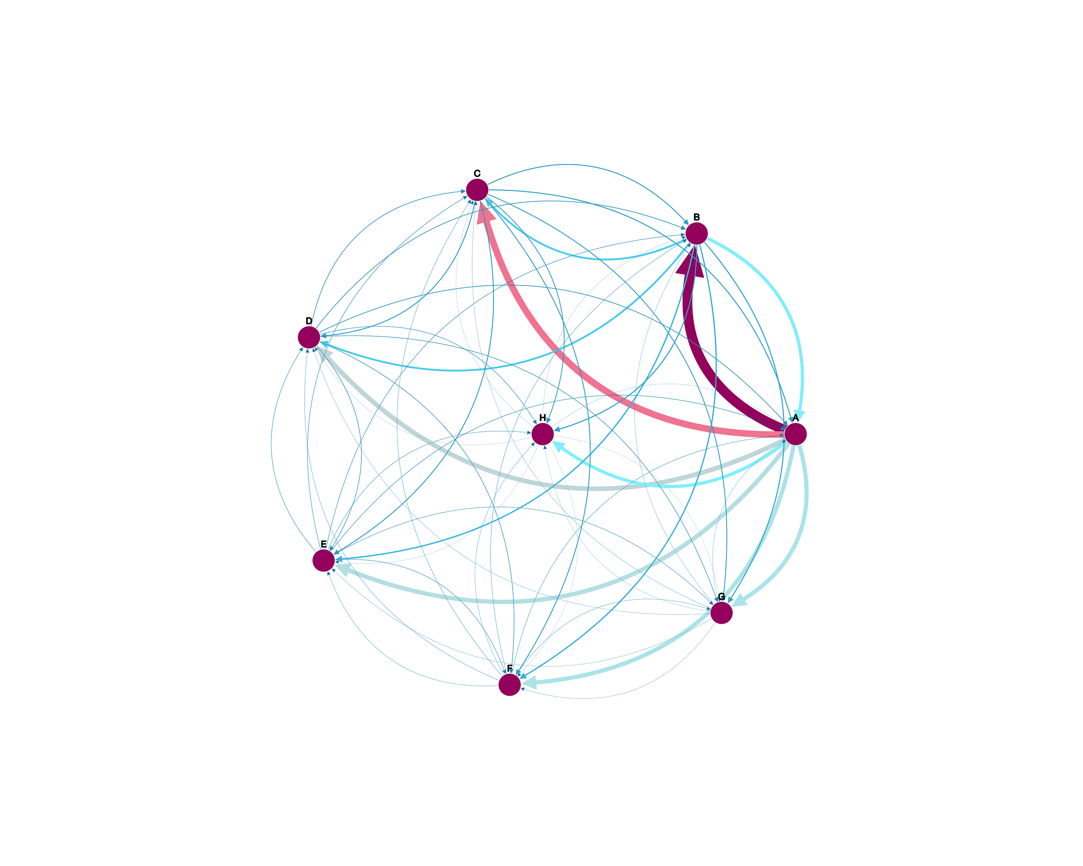
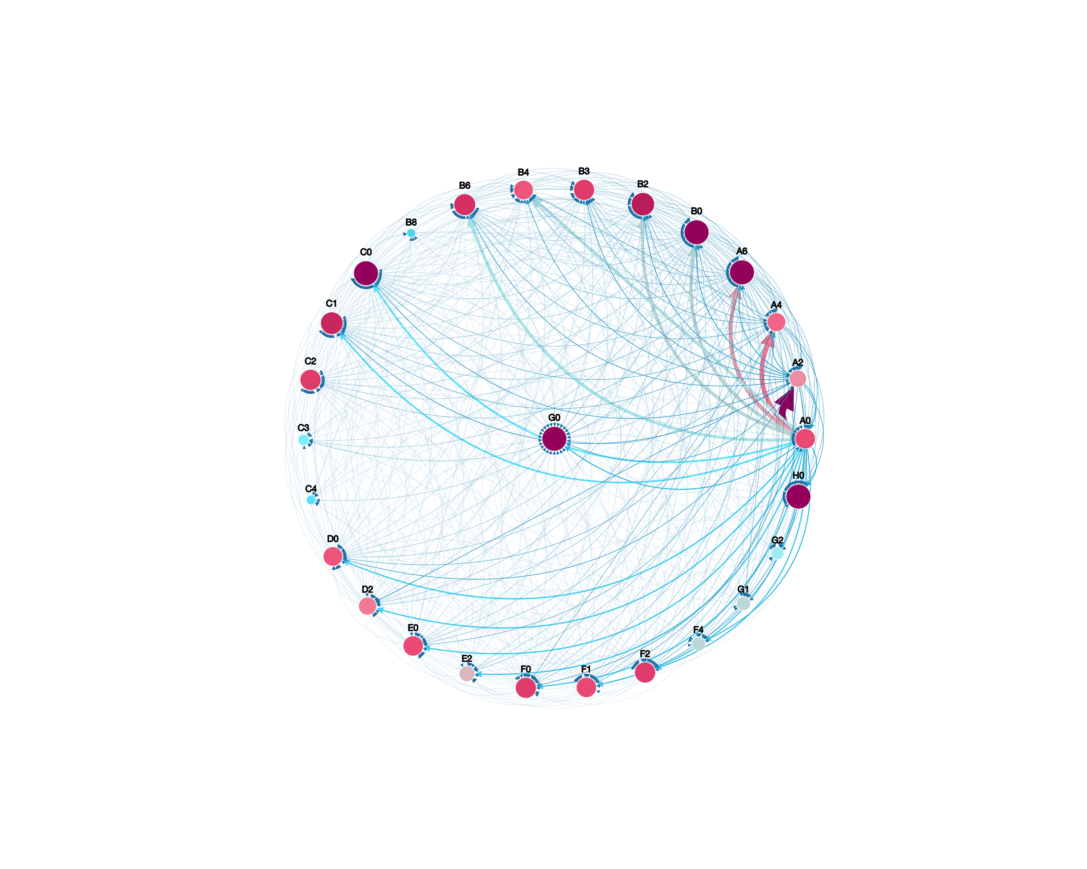
Fig. 4: Un-Normalised network of IPC citations at a precision of a single character (left) and two characters (right).

Slide 5
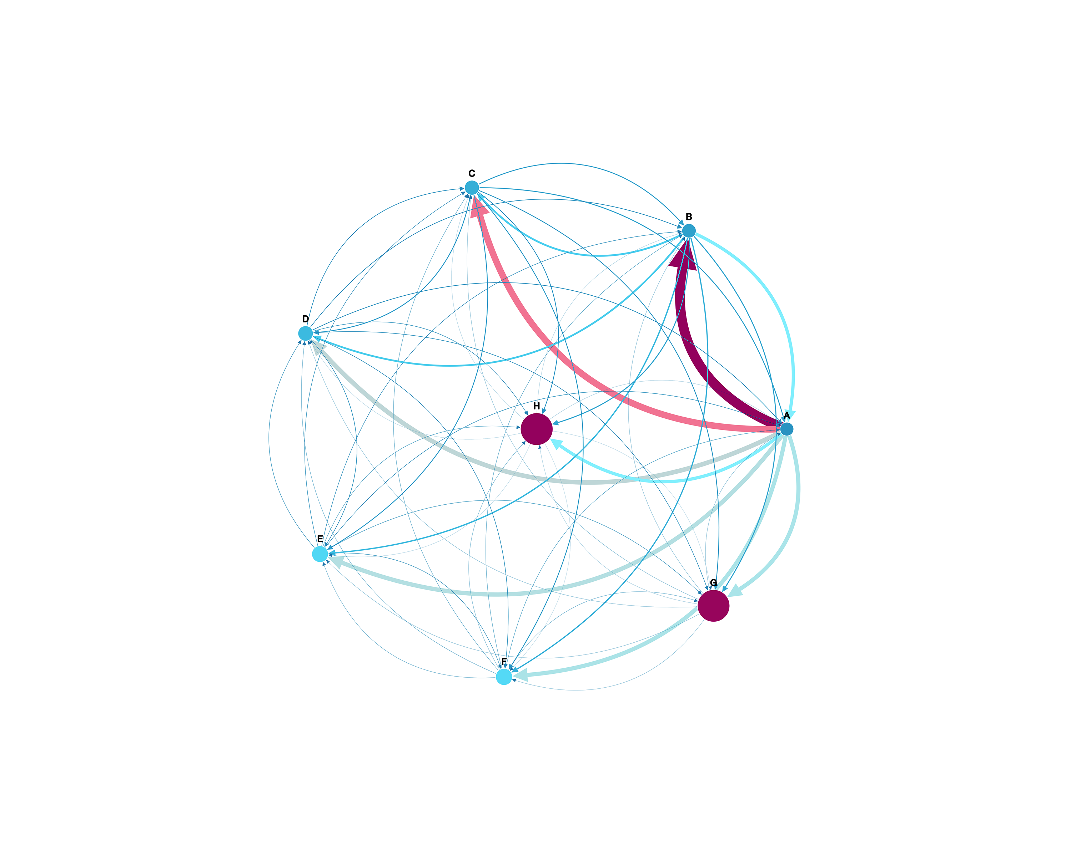
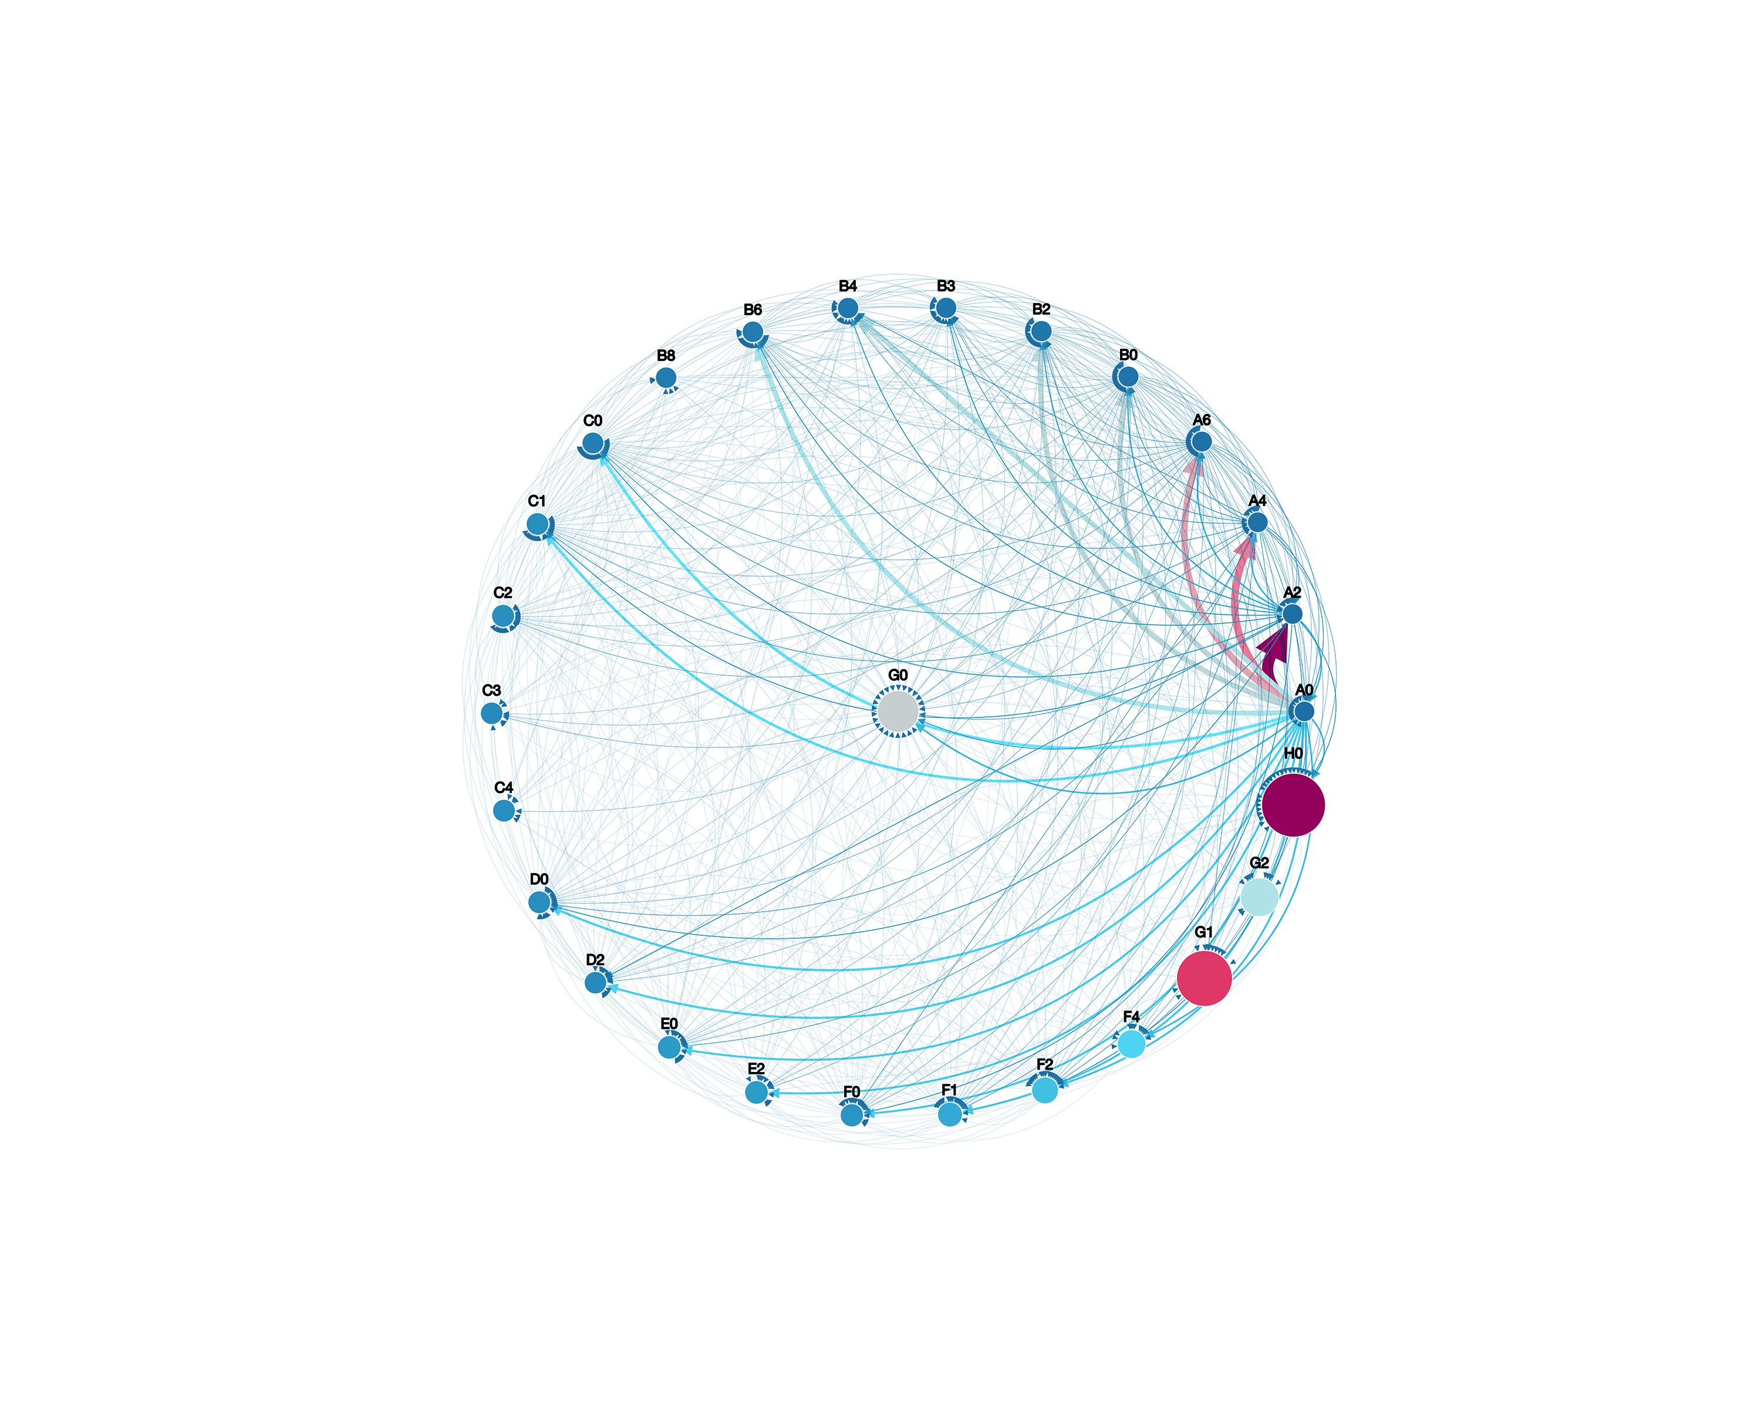
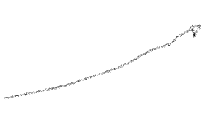

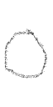
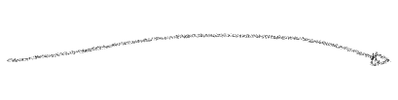
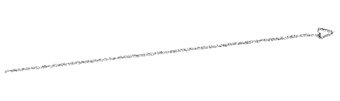
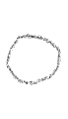
Fig. 5: Normalised network of IPC citations at a precision of a single character (left) and two characters (right).

Slide 6
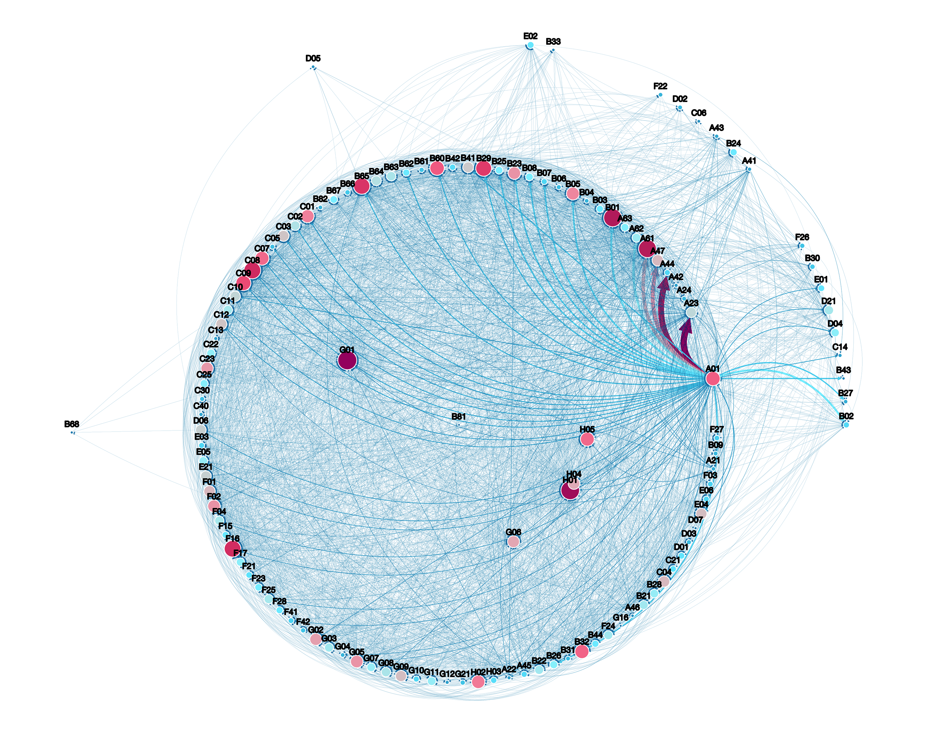
• Insert list of most important nodes
Fig. 6: Un-normalised network of IPC citations at a precision of a single character (left) and two characters (right).

Slide 7
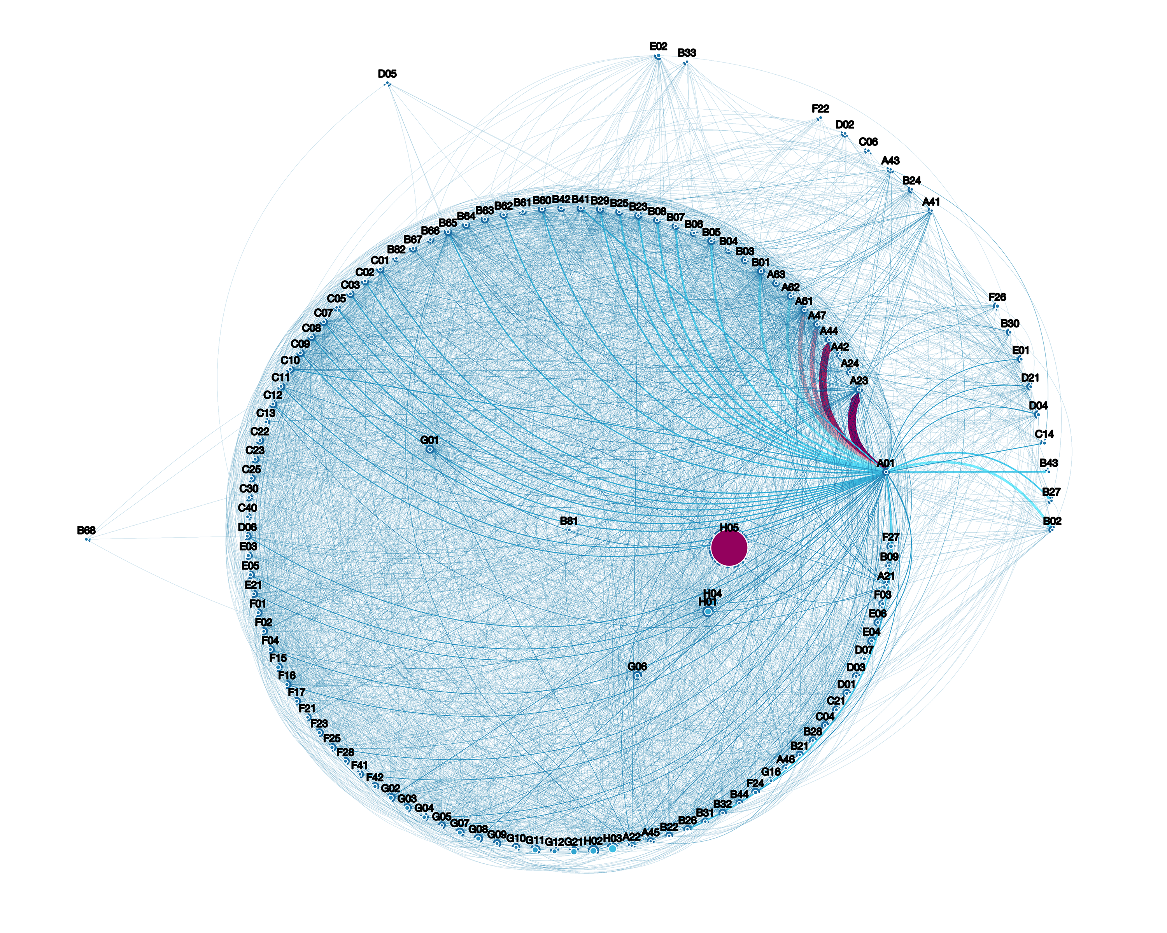

Fig. 7: Normalised network of IPC citations at a precision of a single character (left) and two characters (right).
• Verify these results as they may simply arise from a fluke
• Insert list of most important nodes
H05: “Electric techniques not otherwise provided for.”

Slide 8
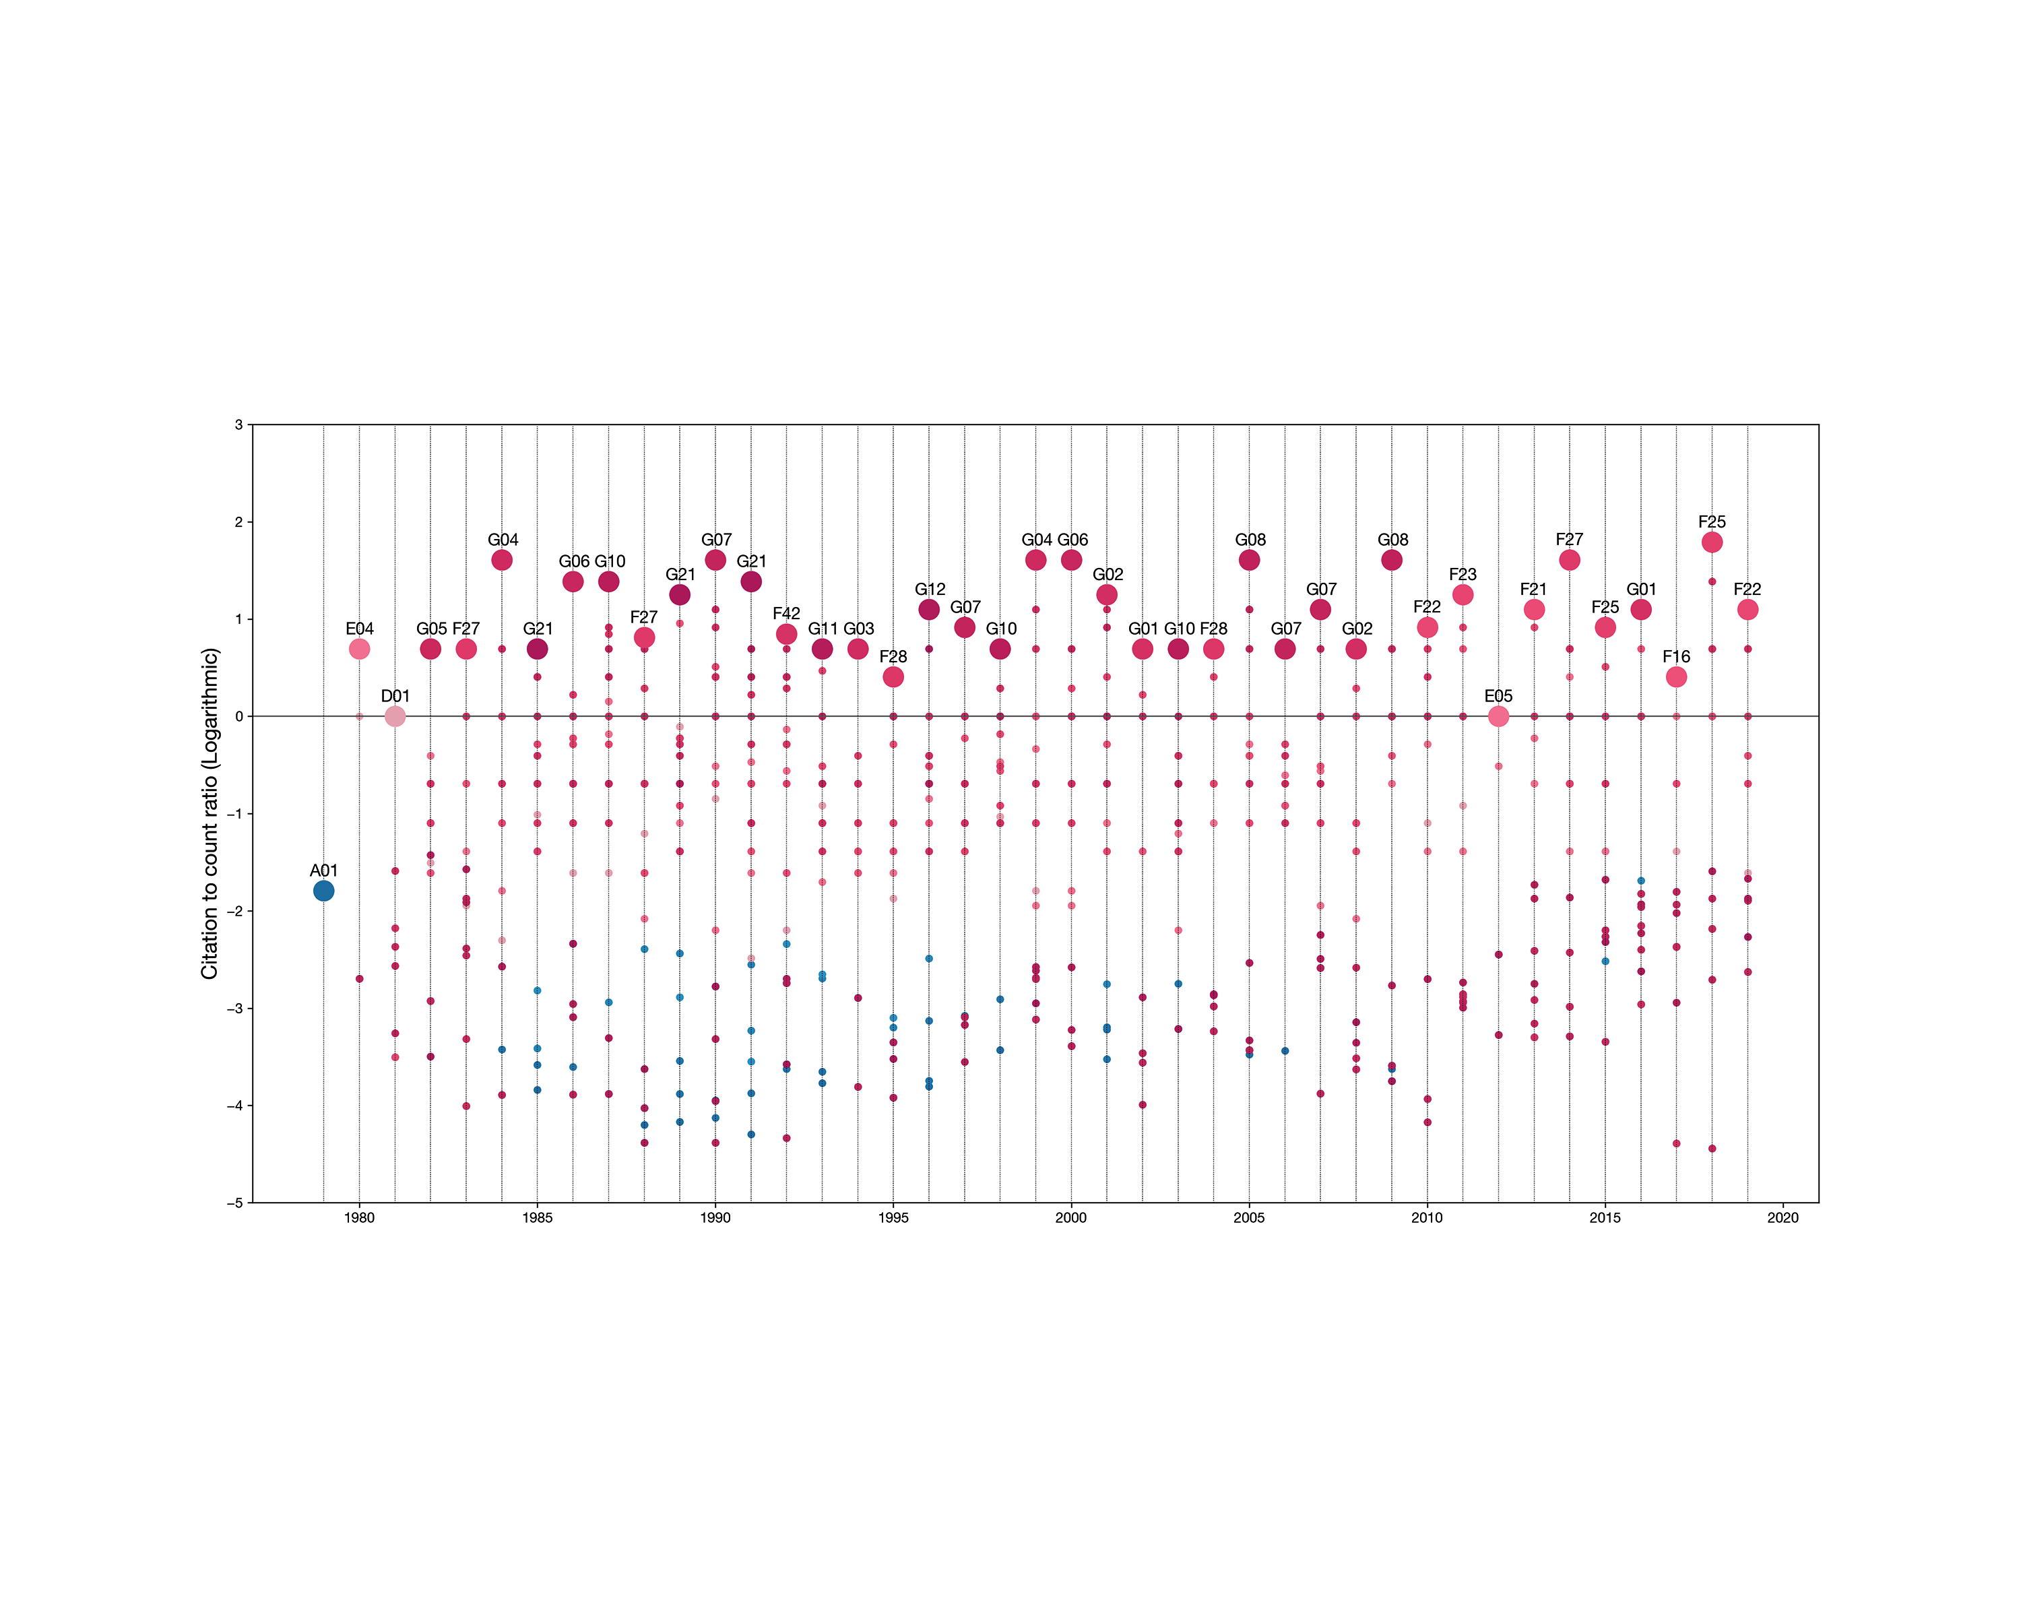
Fig. 8: Normalised IPC citation counts within the same year

Slide 9
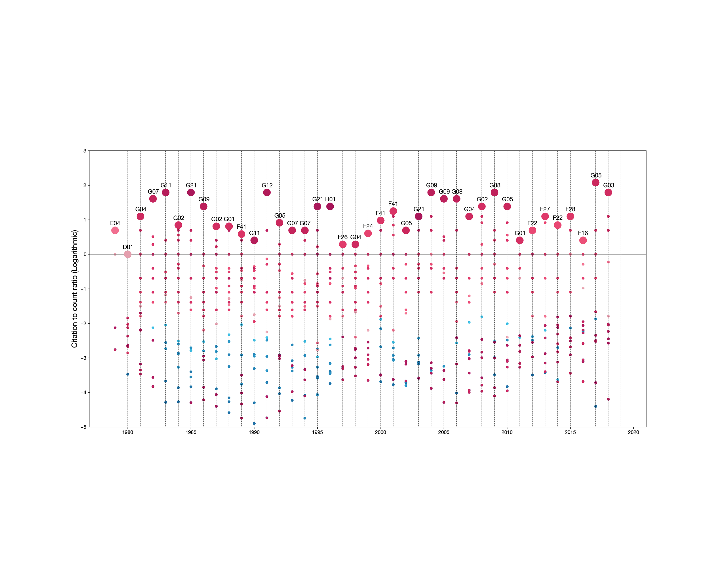
Fig. 9: Normalised IPC citation counts within the previous two years

Slide 10
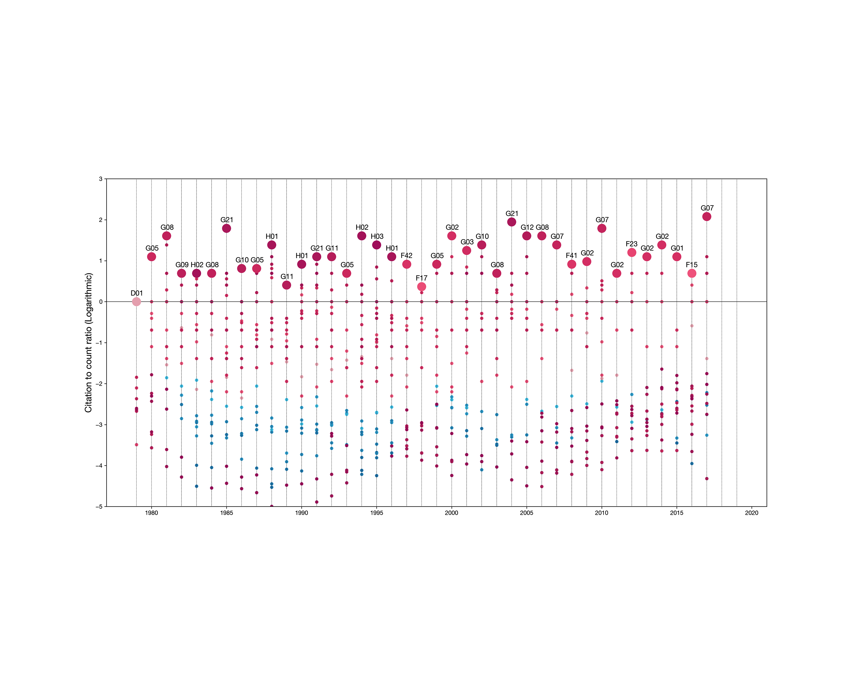
Fig. 10: Normalised IPC citation counts within the previous three years

Slide 11
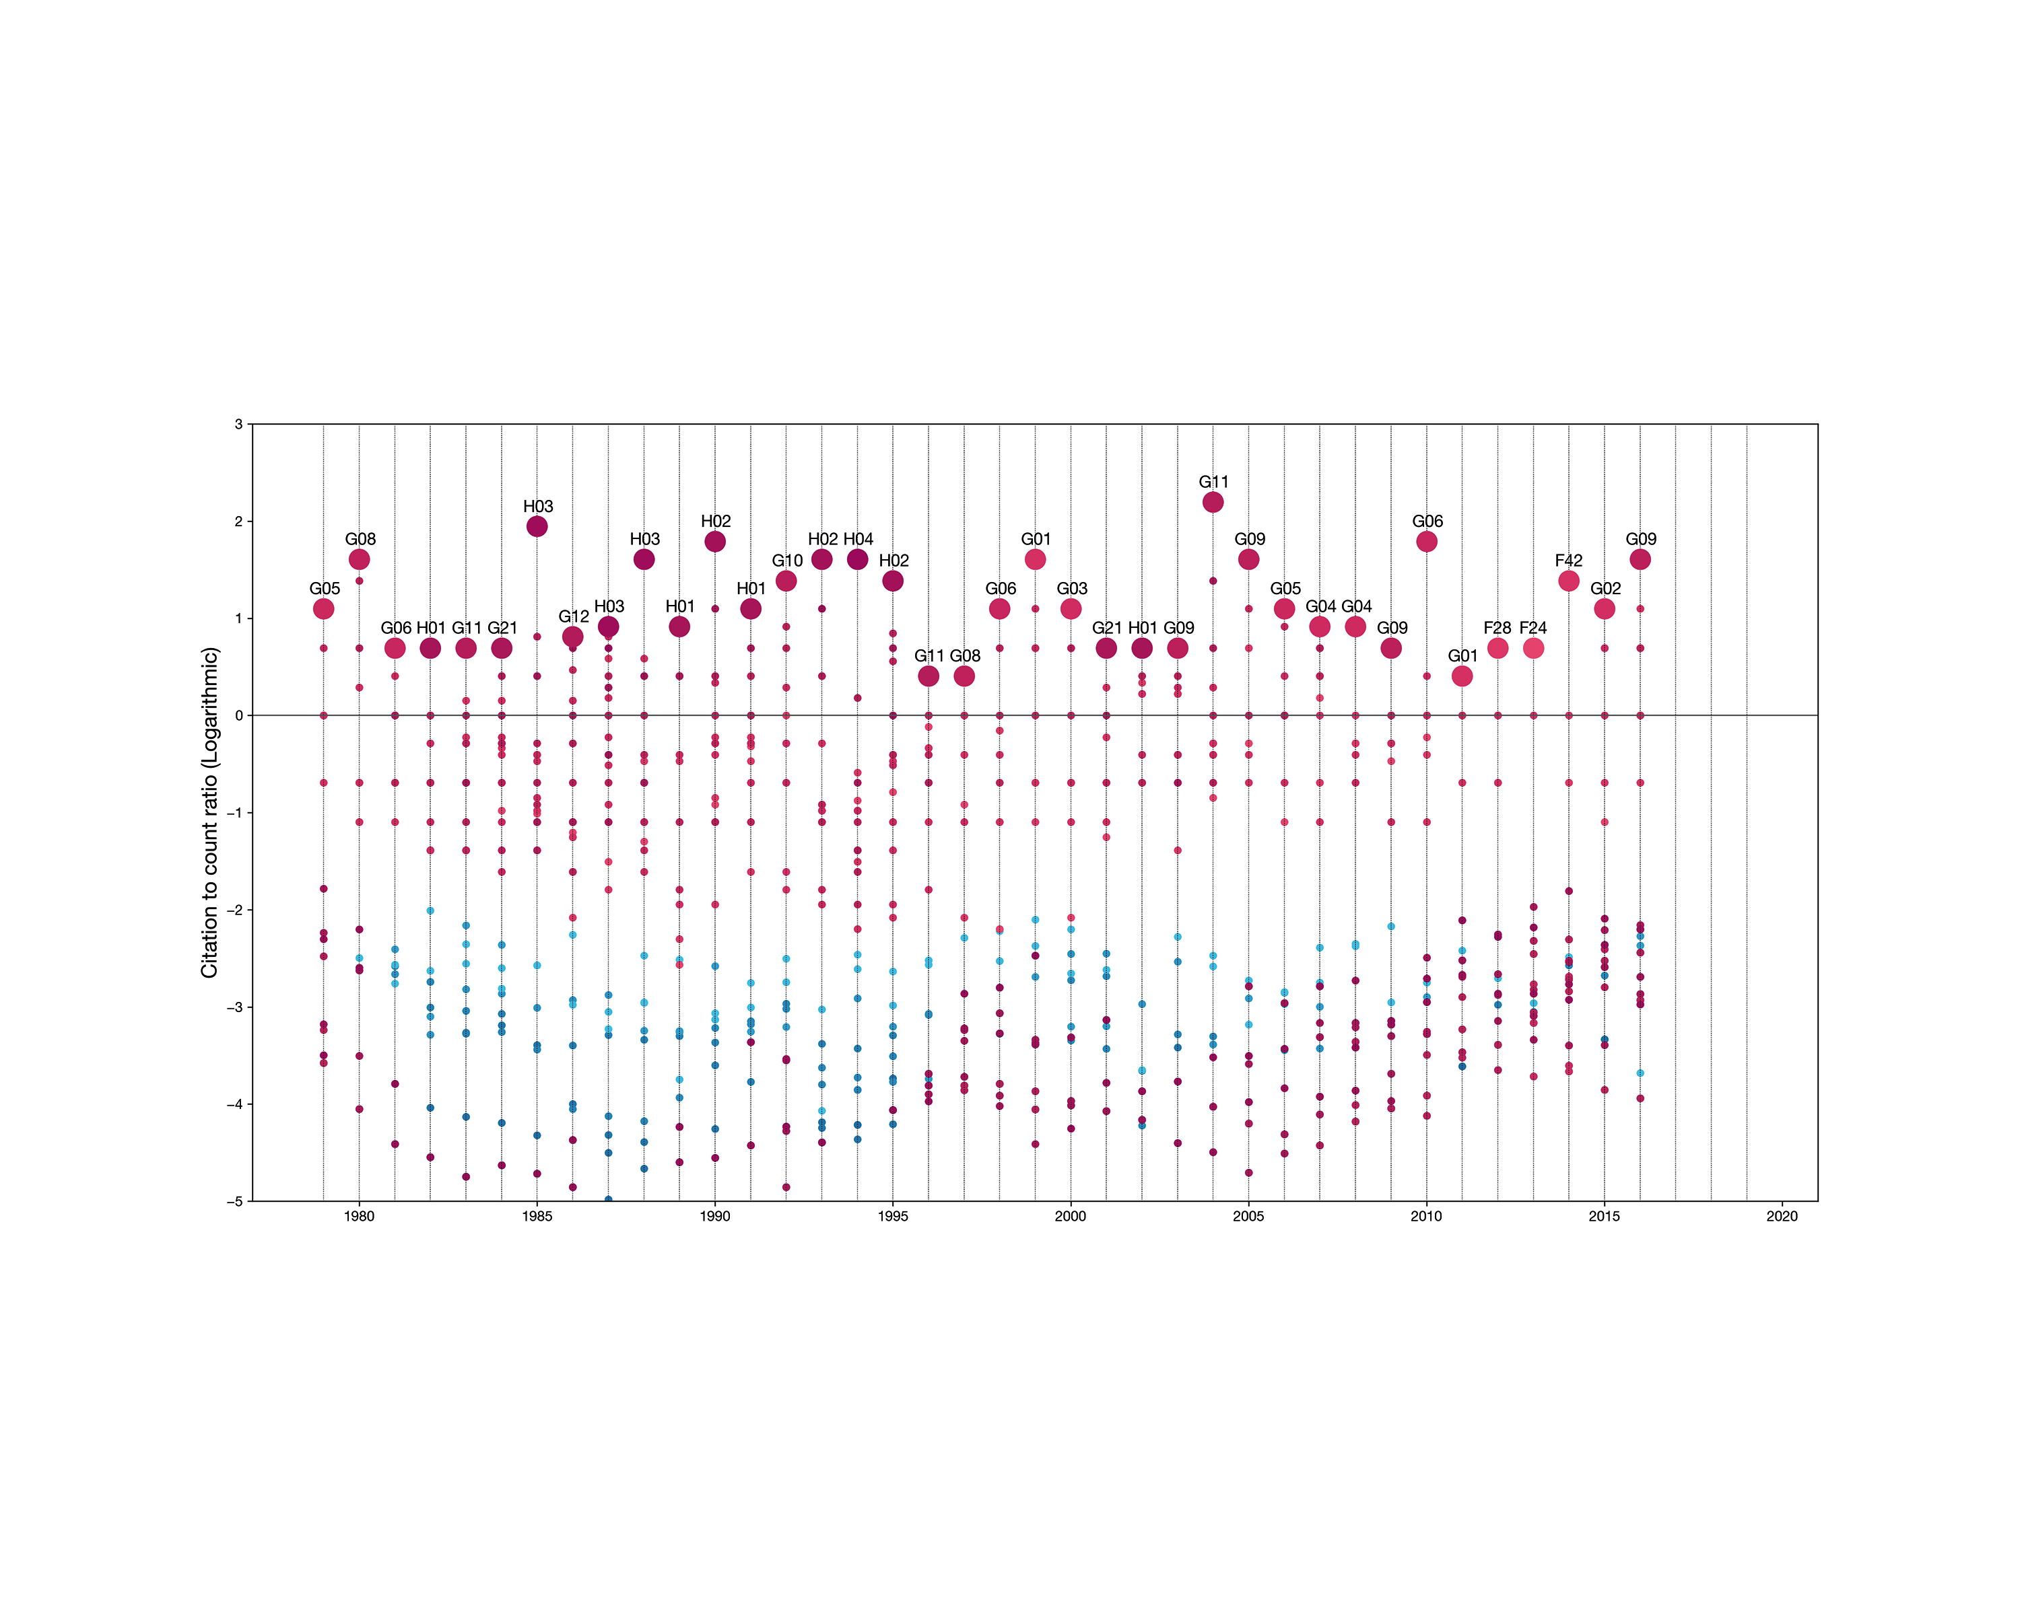
Fig. 11: Normalised IPC citation counts within the previous four years

Slide 12
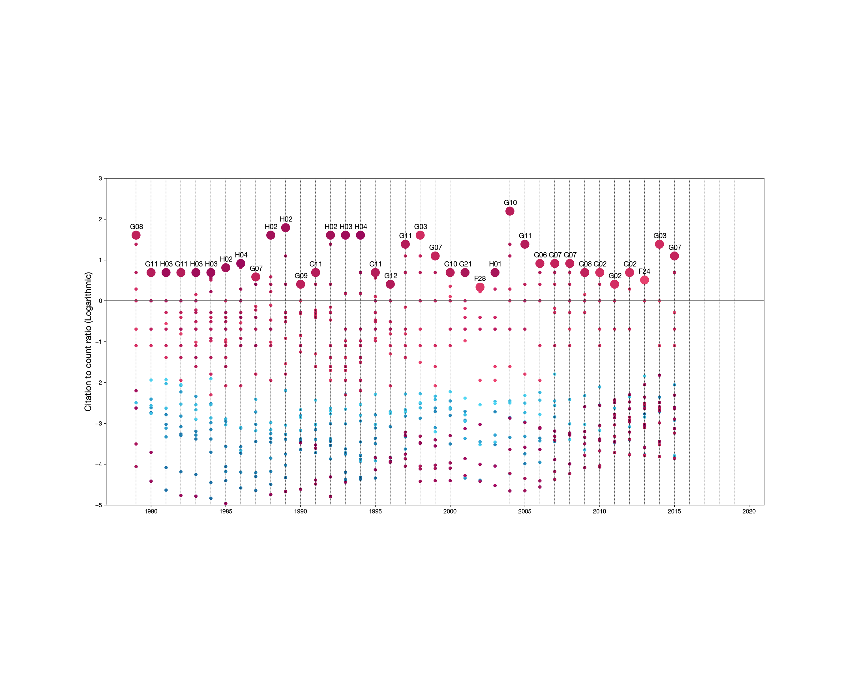
Fig. 12: Normalised IPC citation counts within the previous five years

Slide 13







$$n$$

Slide 14












• Add the additional function in the equation
$$f_{i}(N)$$
$$A_{i}=f_{i}(\log_{α}\left(N+1\right))$$
$${D_{i}=−\left[η\frac{∂A_{i}(N)}{∂N}\right]}^{−1}$$
$$N$$

Slide 15

Fig. 13: Relative logarithmic diversity distribution for IPC A61
• Introduce additional diversity measures and explore how they compare to this one
IPC | Diversity Measure (D_{i}) | Description
A61 | 5.01 | Medical or veterinary science; hygiene
C08 | 4.87 | Organic macromolecular compounds; their preparation or chemical working-up; compositions based thereon
C07 | 4.76 | Organic chemistry
G01 | 4.72 | Measuring; testing
B01 | 4.64 | Physical or chemical processes or apparatus in general
C09 | 4.59 | Dyes; paints; polishes; natural resins; adhesives; compositions not otherwise provided for; applications of materials not otherwise provided for
H01 | 4.43 | Electric elements
F16 | 4.17 | Engineering elements or units; general measures for producing and maintaining effective functioning of machines or installations; thermal insulation in general
B65 | 3.84 | Conveying; packing; storing; handling thin or filamentary material
G02 | 3.51 | Optics
• Add example of a less diverse IPC

Slide 16
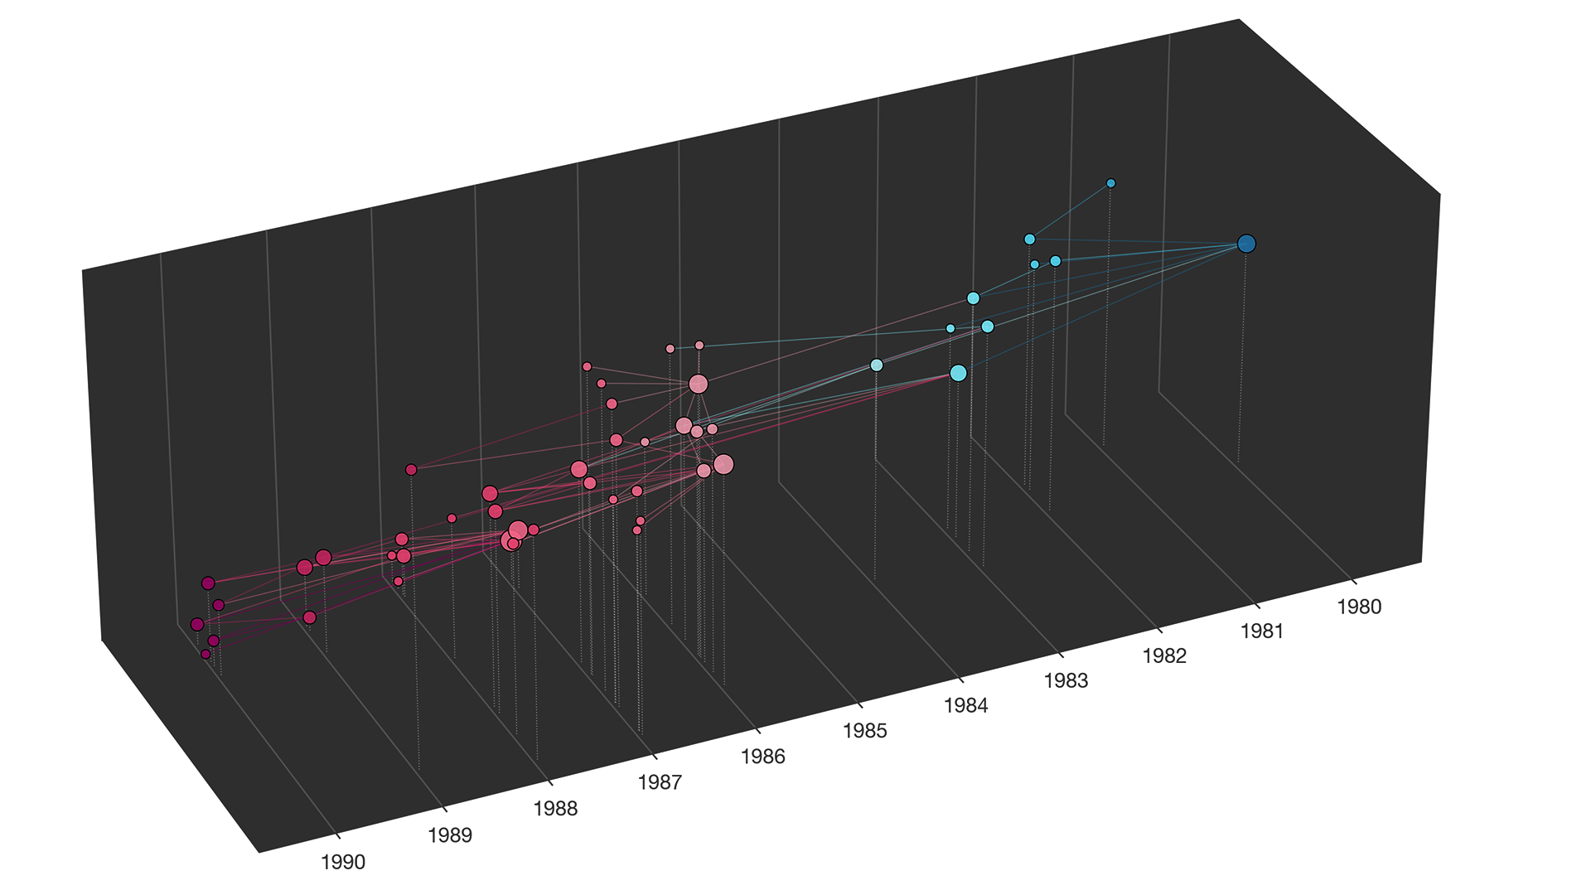

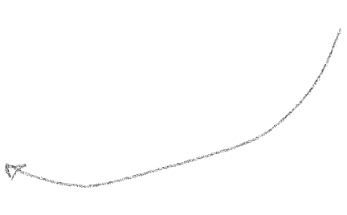



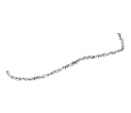



Fig. 14: A connected component of patent citations
• Explore the shortest path as a means of following ‘vital ideas’

Slide 17
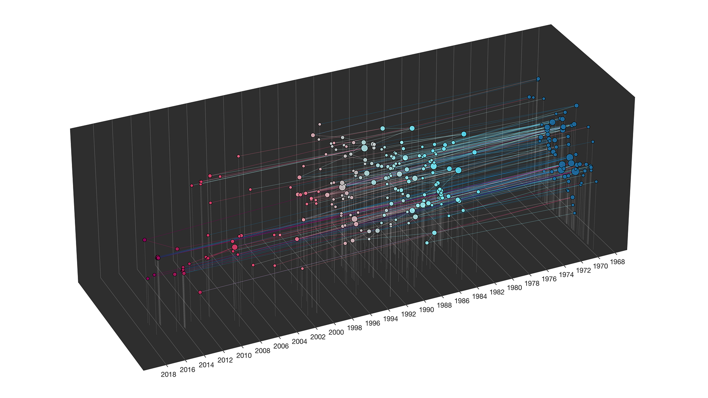
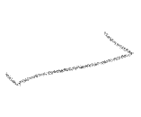
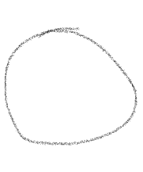
Fig. 14: Another large connected component of patent citations
• Colour the nodes according to their diversity

Slide 18
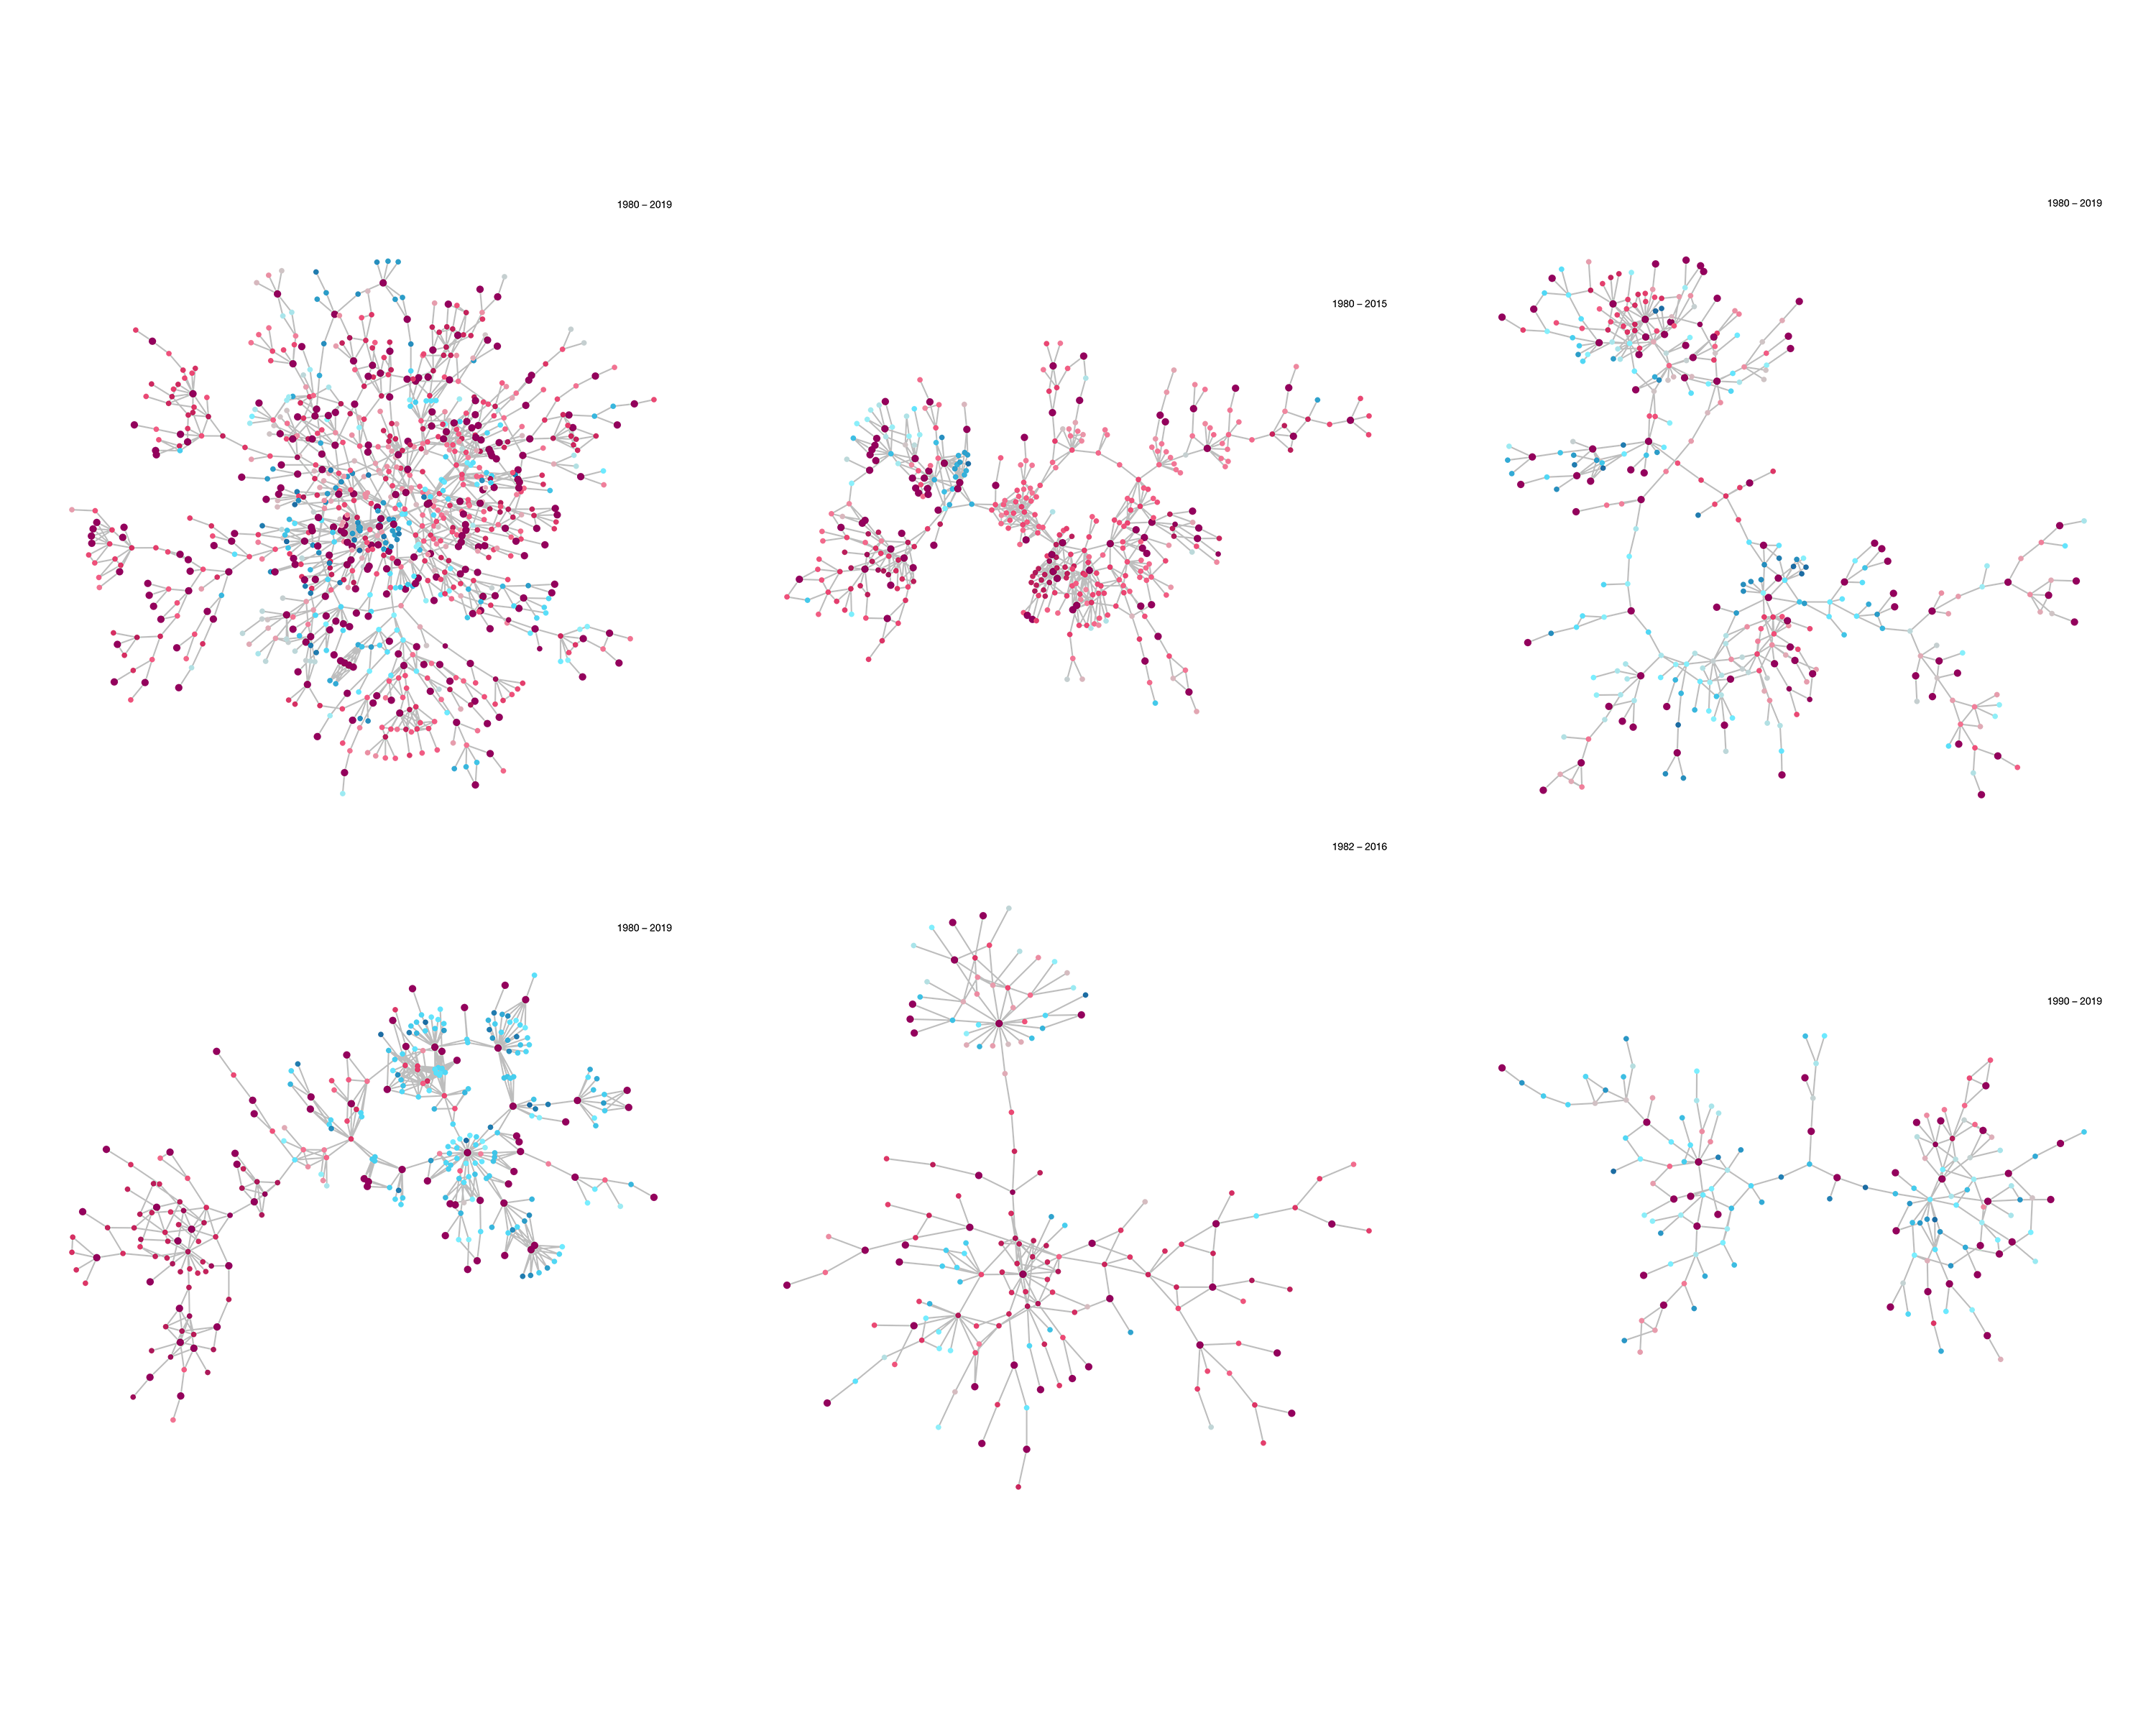

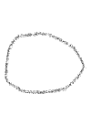







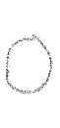
Fig. 15: Largest connected components of patents

Slide 19
Fig. 16: Highlighted biotechnology patents.

Slide 20
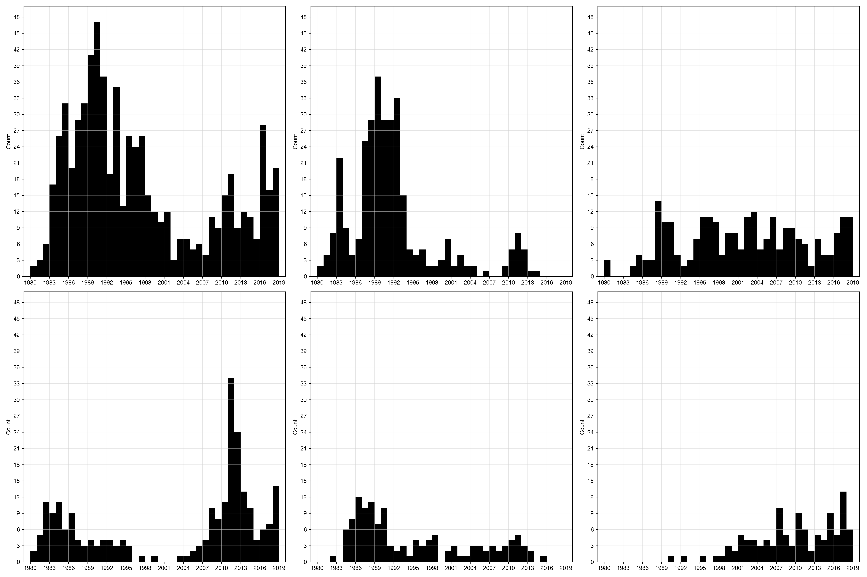
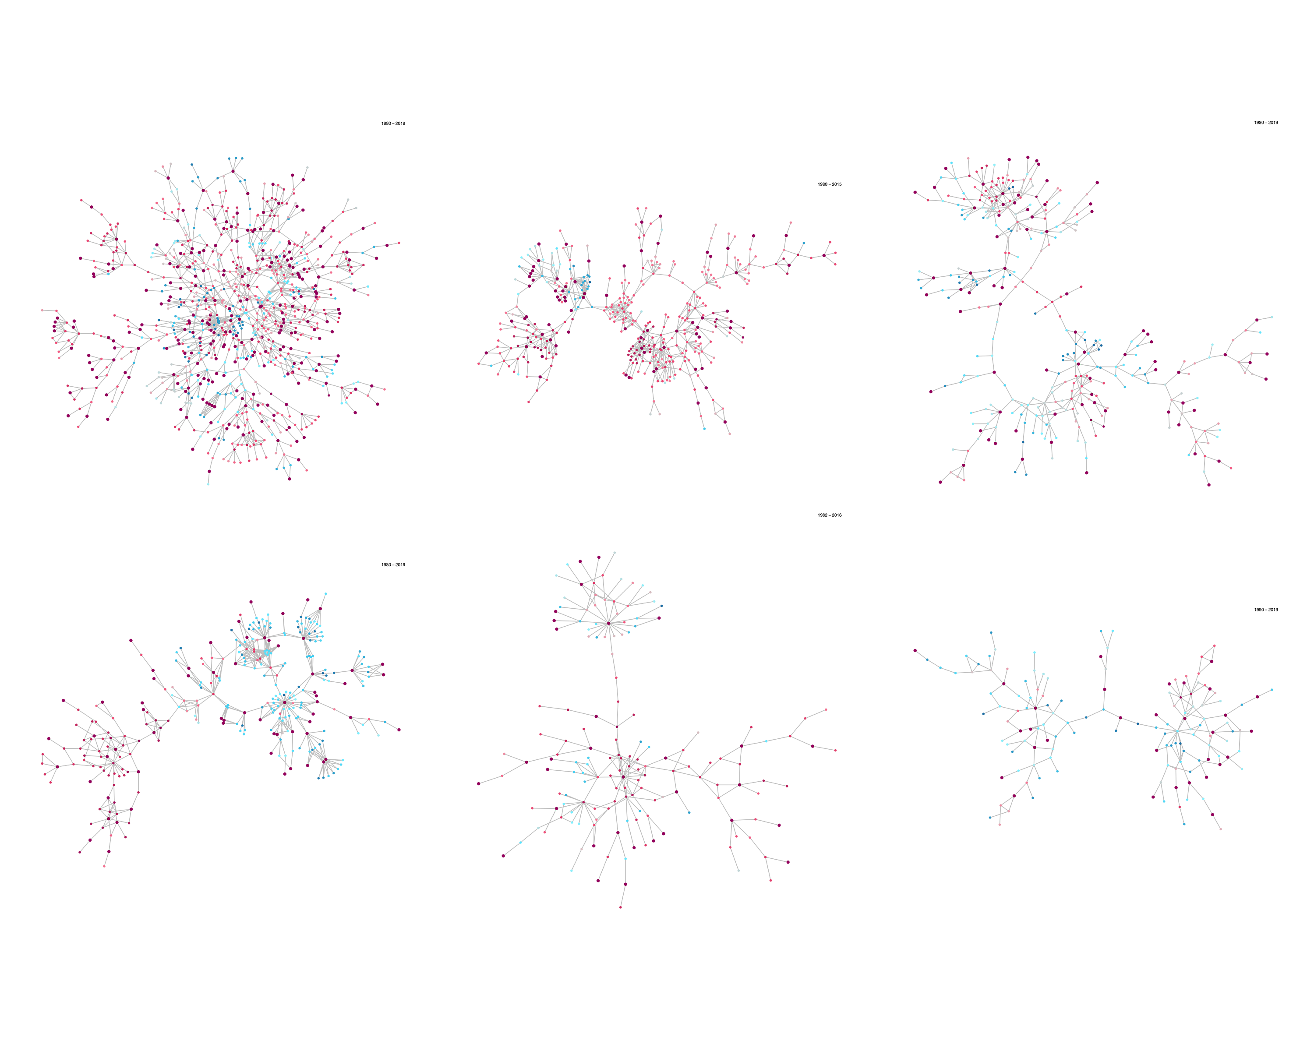
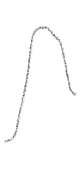

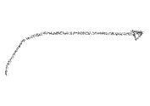
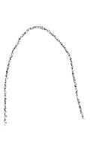
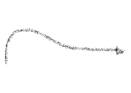



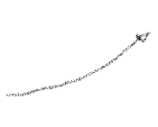
Fig. 17: Patent count evolution for each component

Slide 21
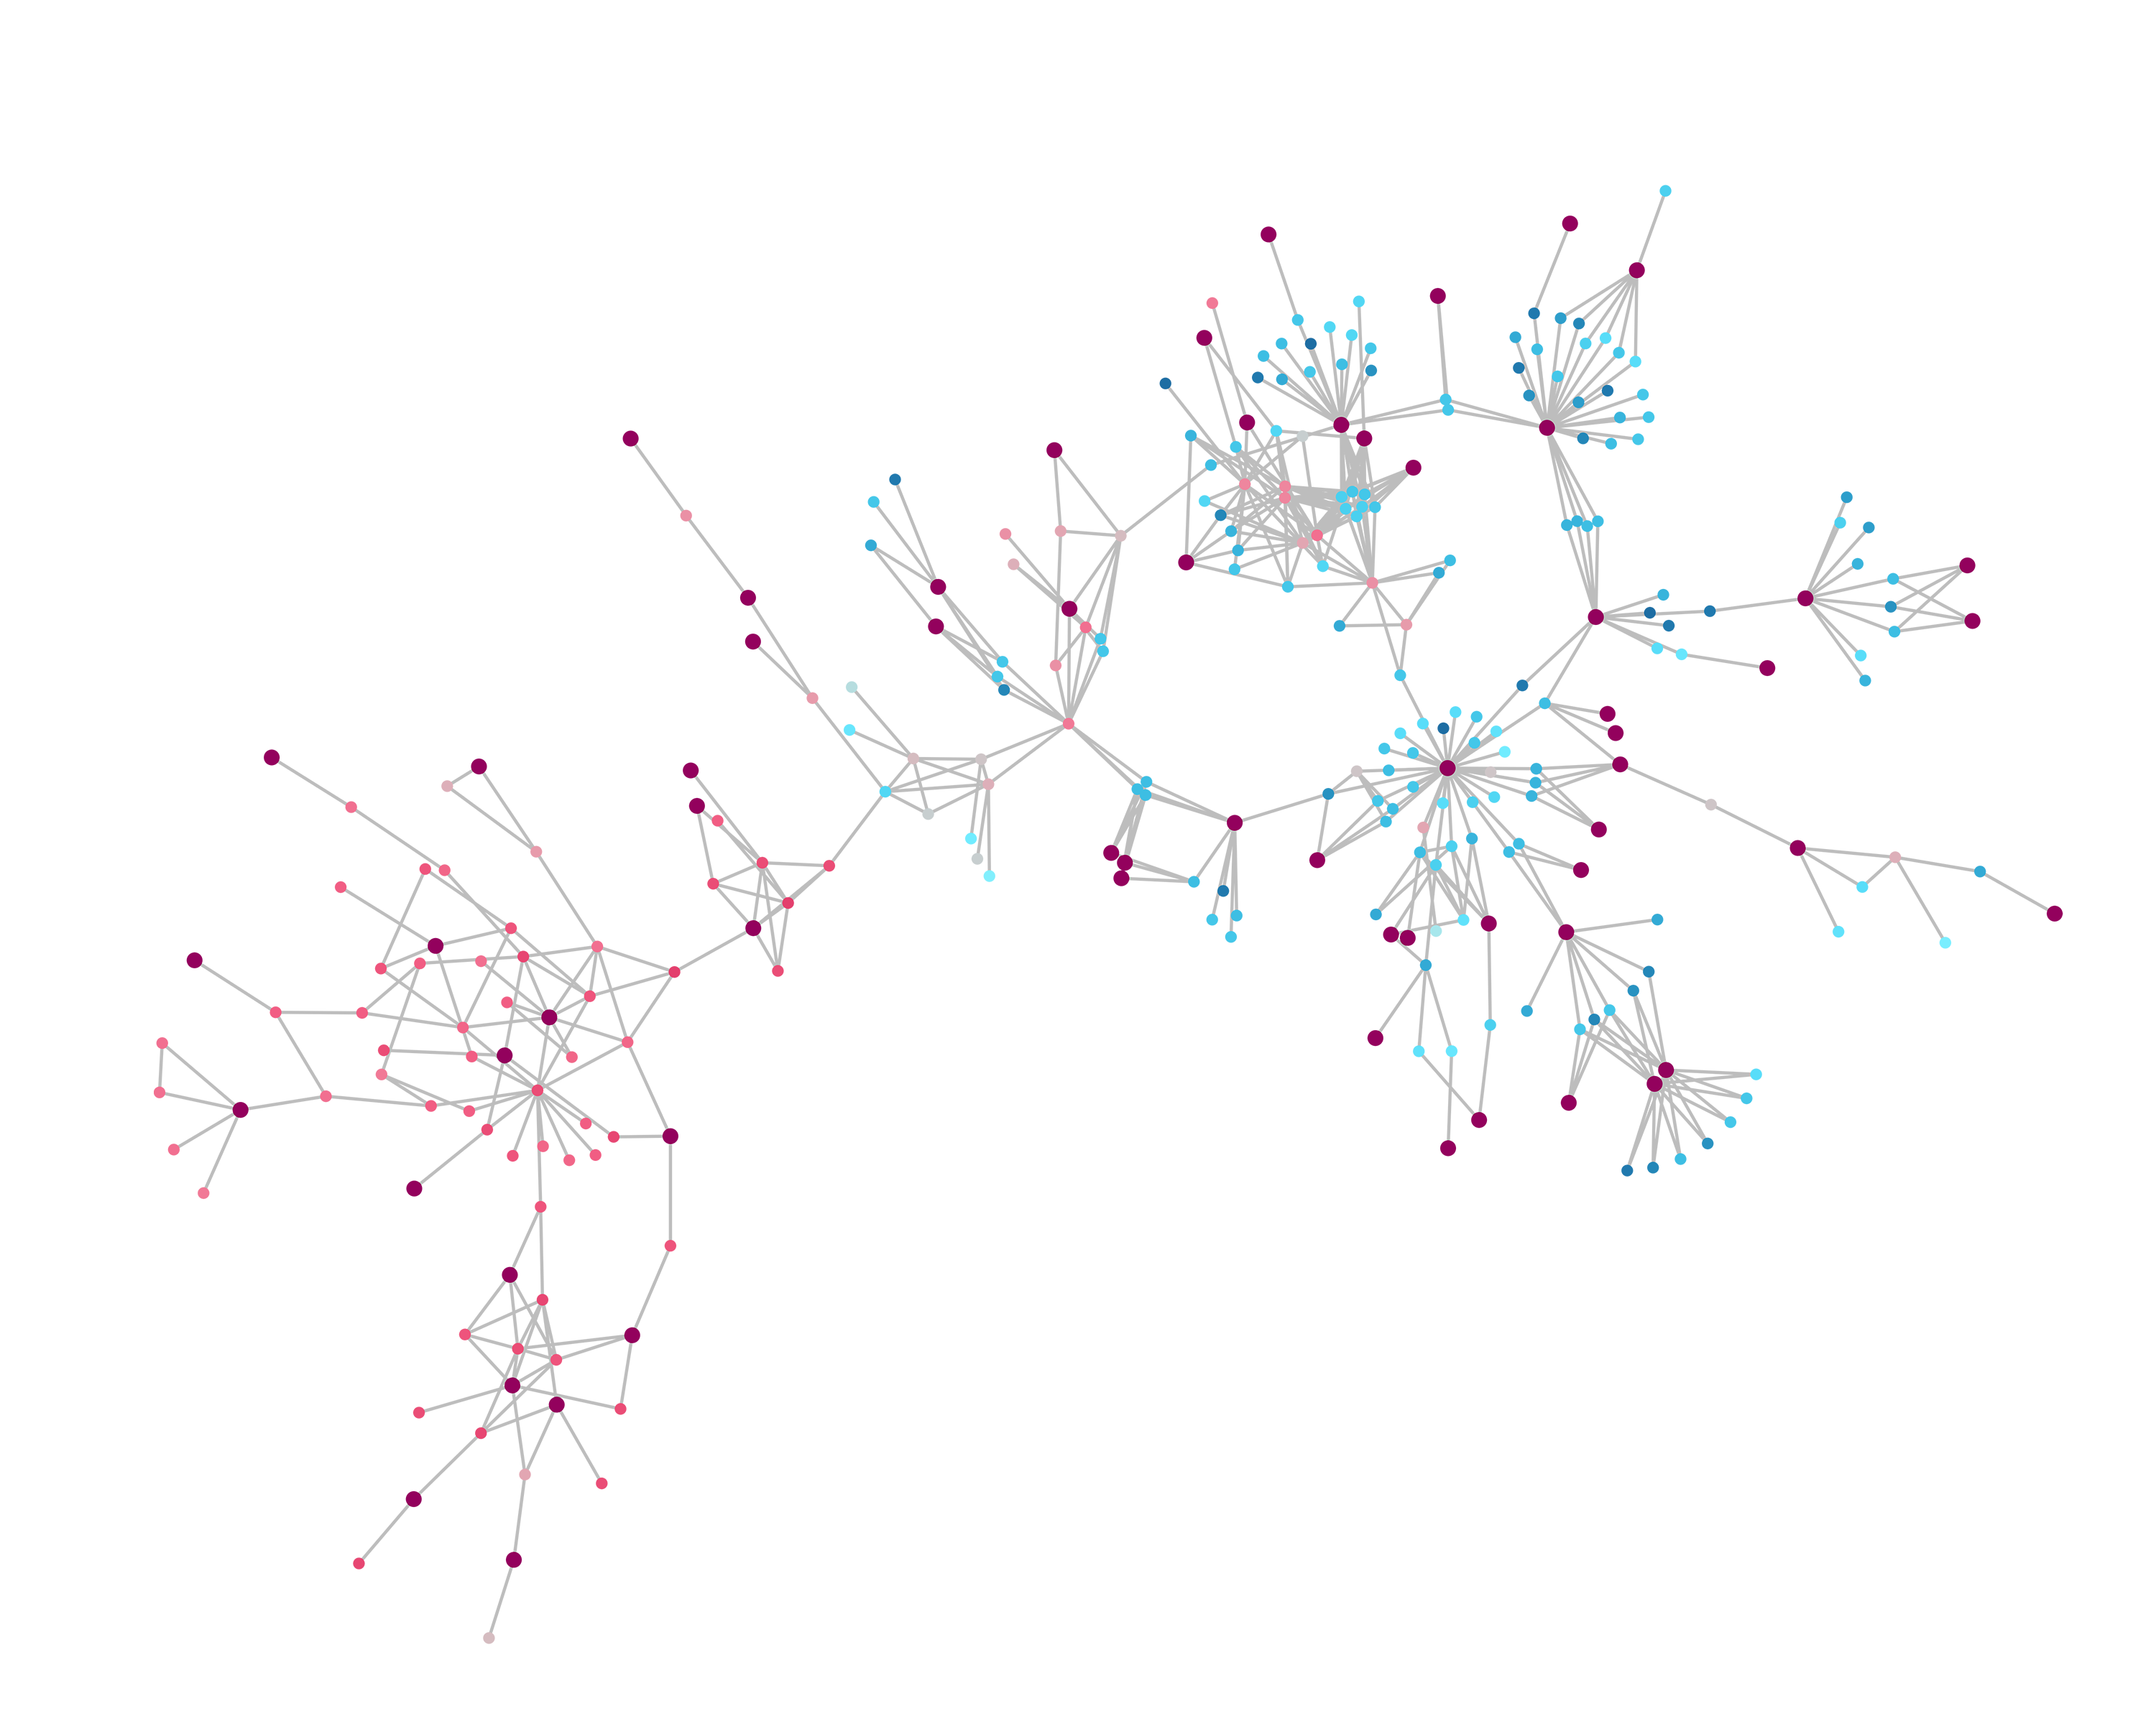
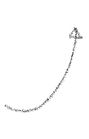
Biotechnology

Slide 22
Fig. 18: Largest connected component containing the most amount of biotechnological patents
• Label the biotech nodes

